Slide 1
Contact: Birgitte Larsen, blarsen@mbg.au.dk
https://mbg.au.dk/en/research/research-centres/iteasc

Slide 2
Pizza after the seminars!
Date | Hosting University | Speaker | Talk title | Facility visit
11 April | Technical University of Denmark | Raimund Mokso |  | The 3D Imaging Center at DTU
2 May, 4pm | Aarhus University | Wolfgang Bush Salk institute for Biological Studies | Engineering Root Traits for Climate Change Mitigation | Cryo-EM Facility Facility manager Thomas Boesen
30 May (tbc) | University of Southern Denmark | TBA |  | TBA
11 June | University of Copenhagen | VR session TBA |  | TBA

Slide 3
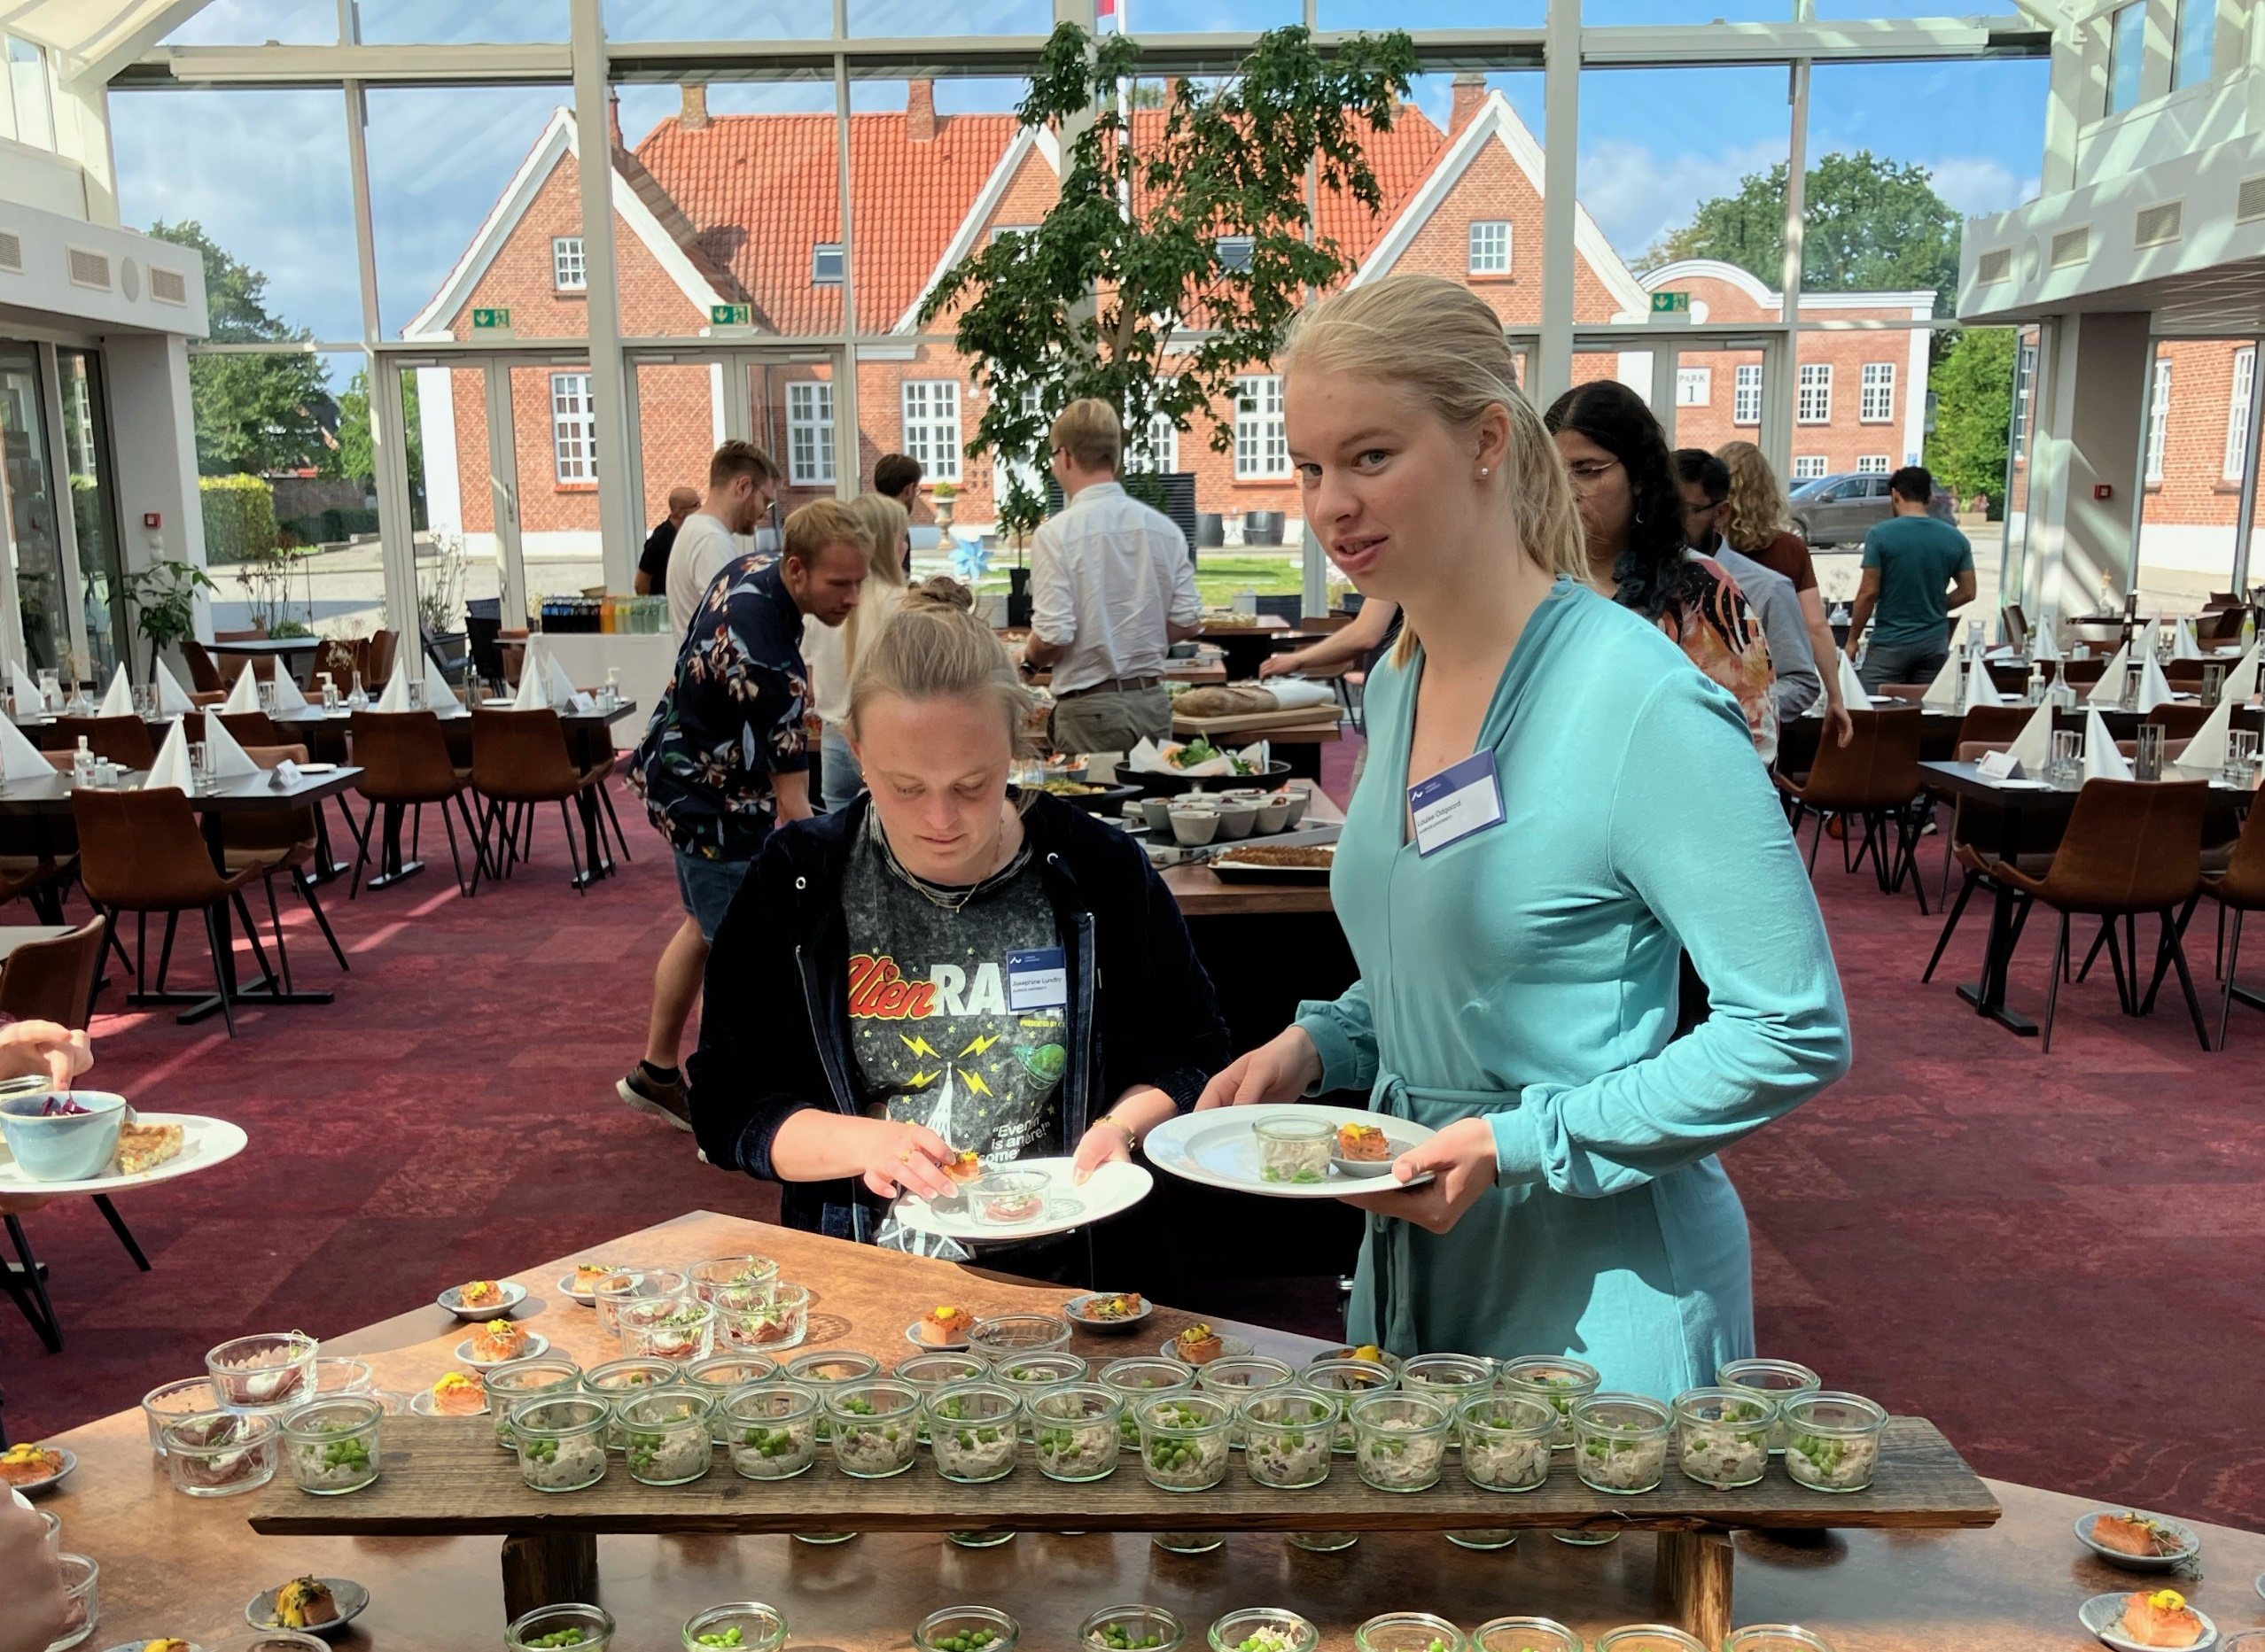
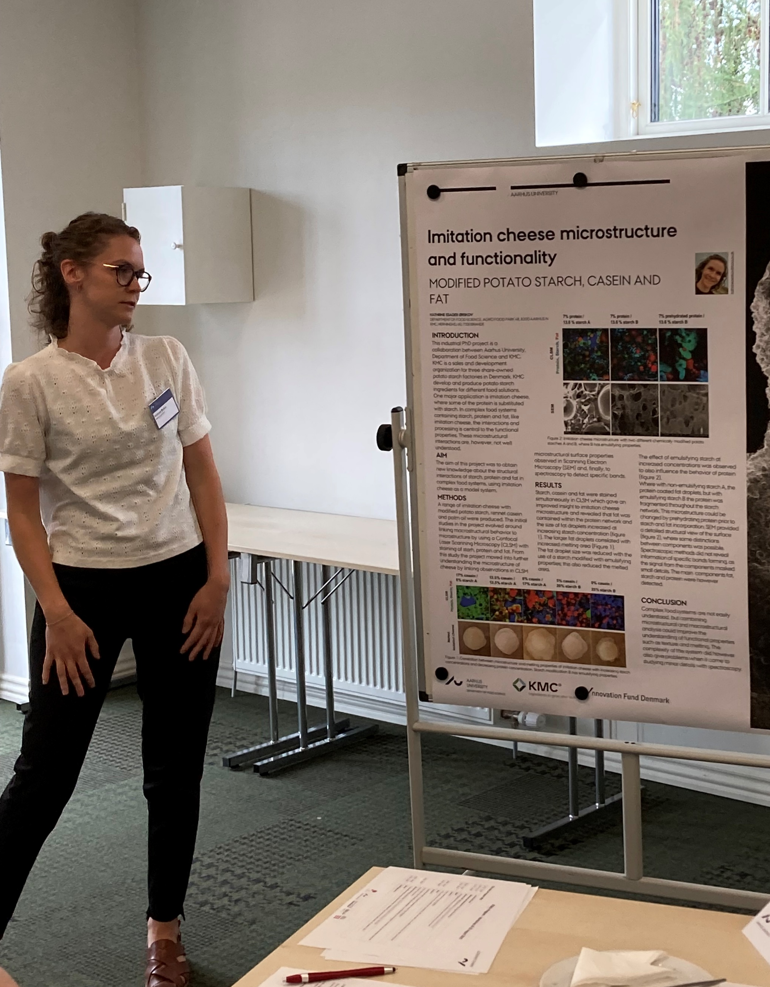
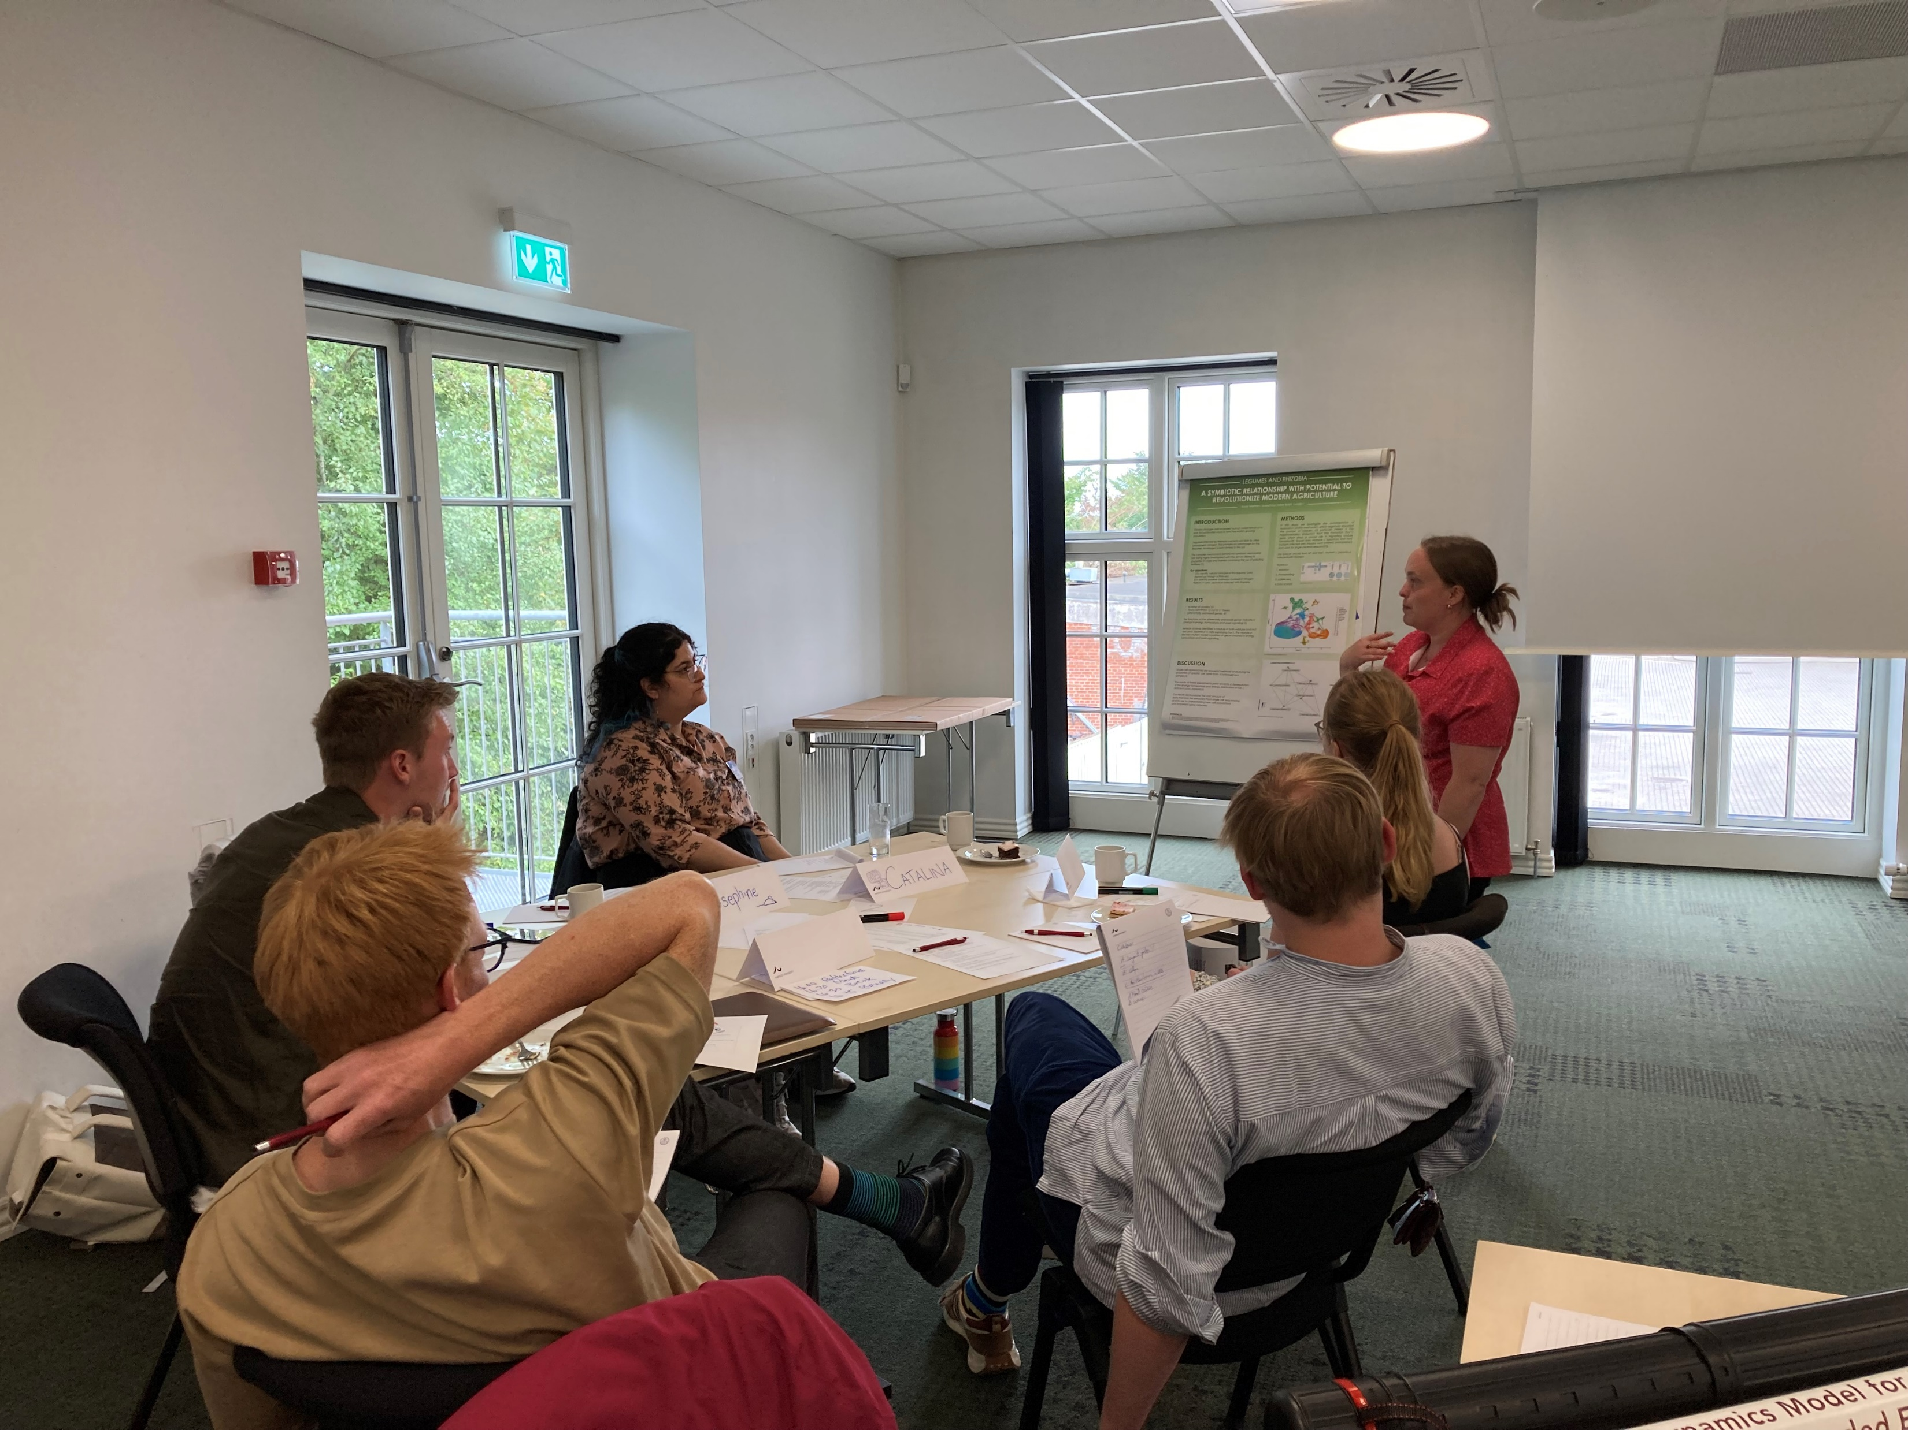
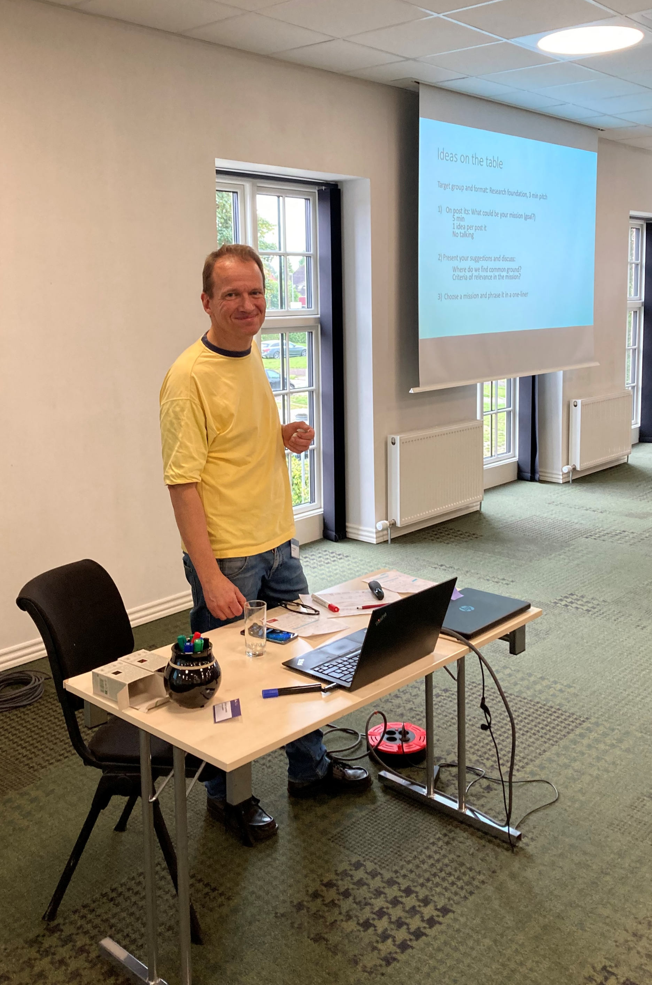
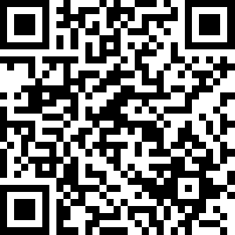
ITEASc Interdisciplinary Interactions Workshop
29-30 August 2024
Develop your scientific communication skills
Network with students and scientists across disciplines
Co-develop new project ideas
I got very valuable feedback and guidelines for smashing my next poster presentation. While also meeting a lot of new people.
- 2023 course student
Scan QR code for more information

Slide 4
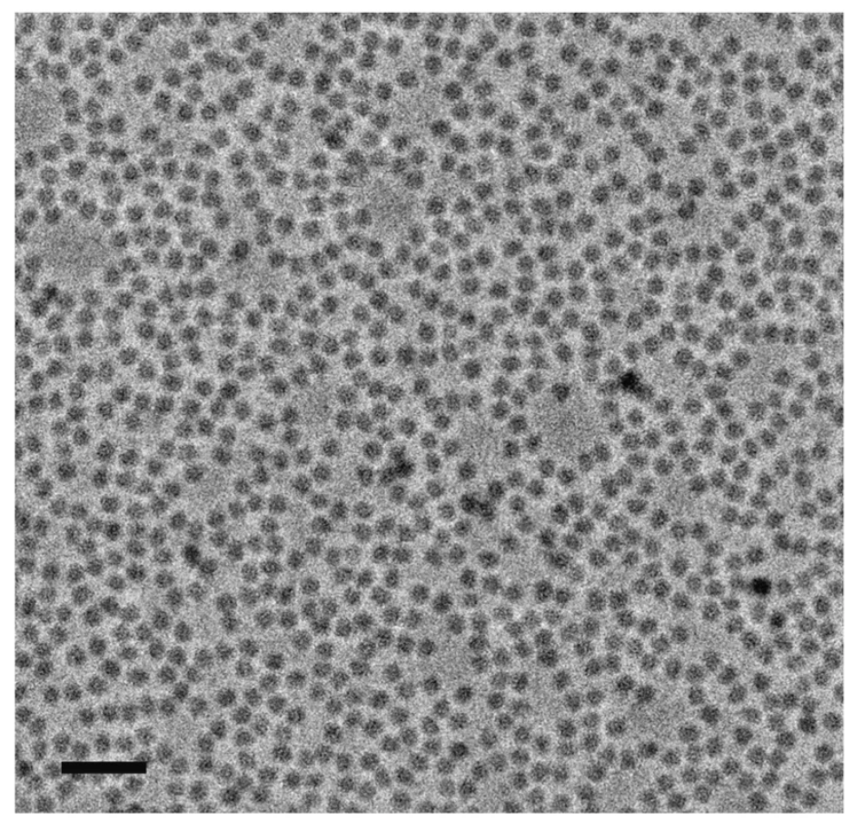
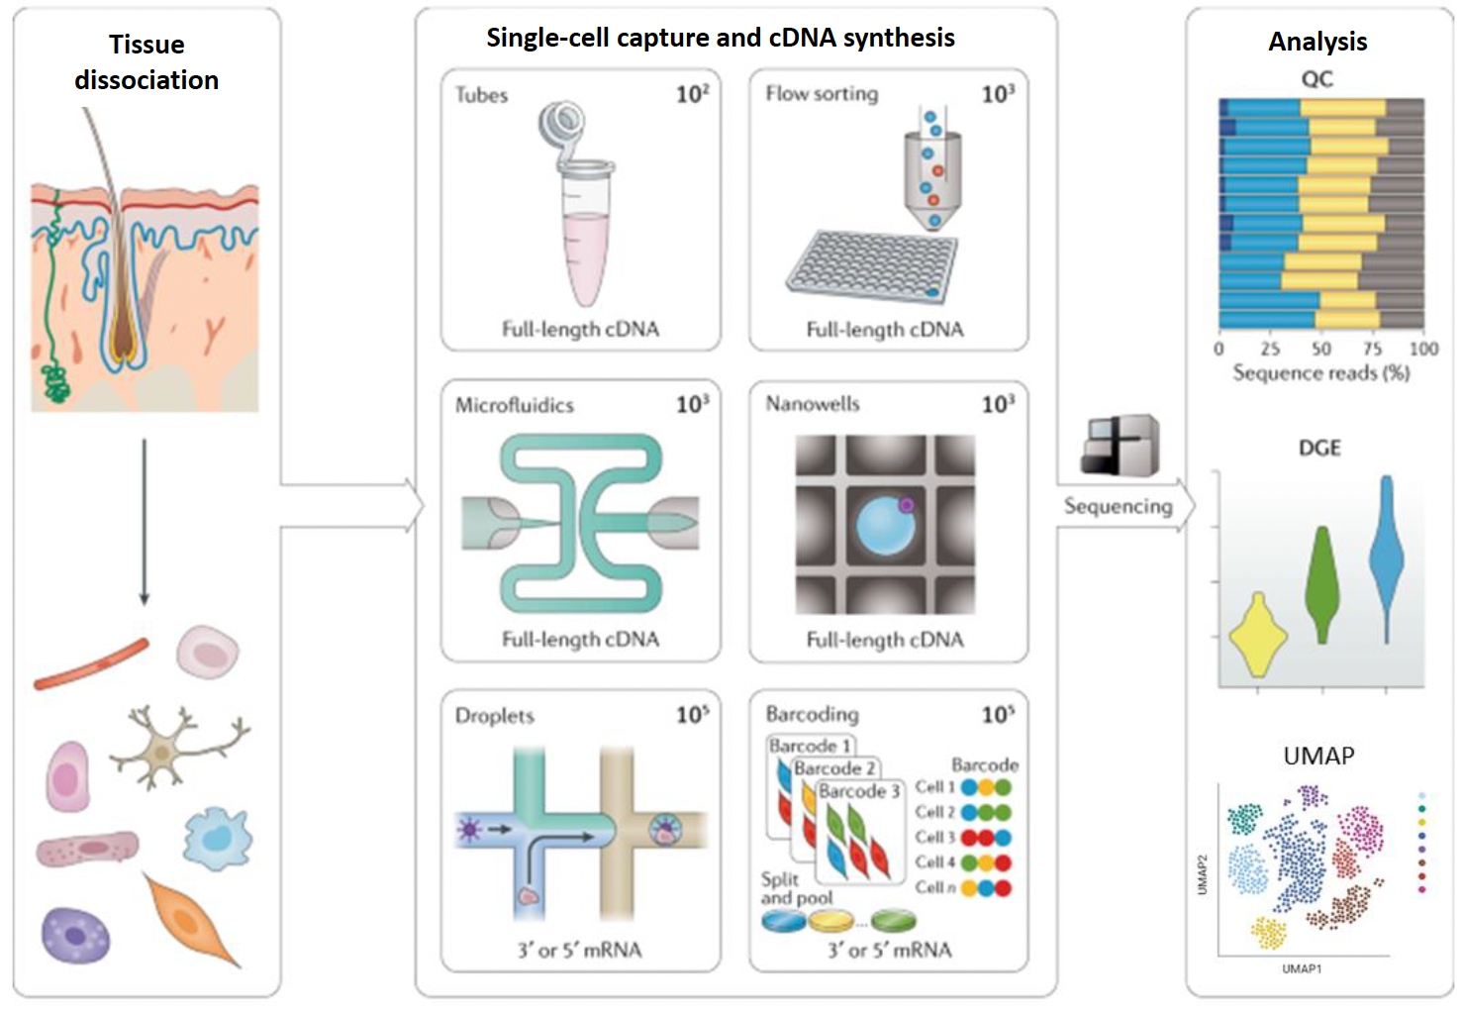
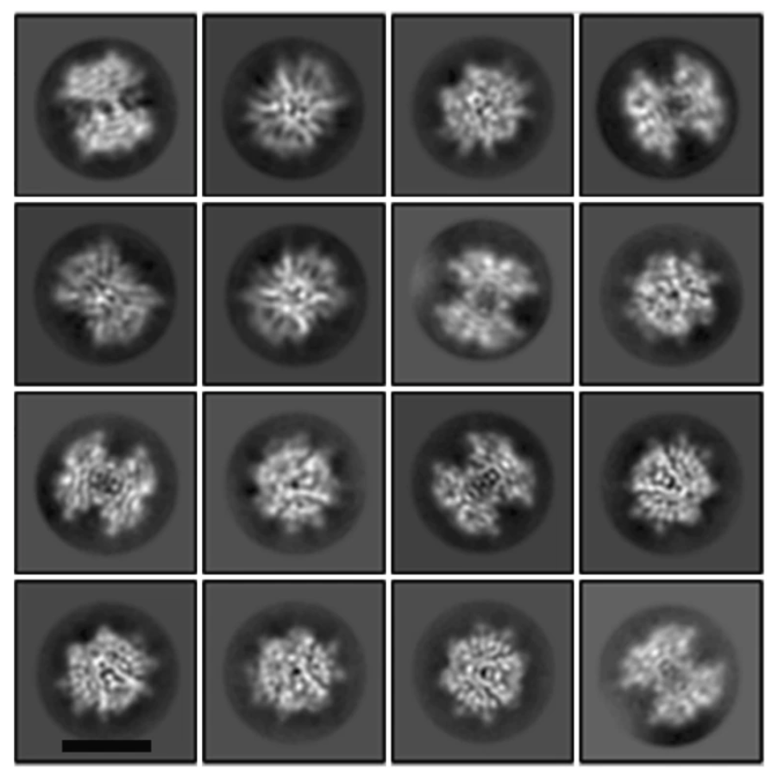
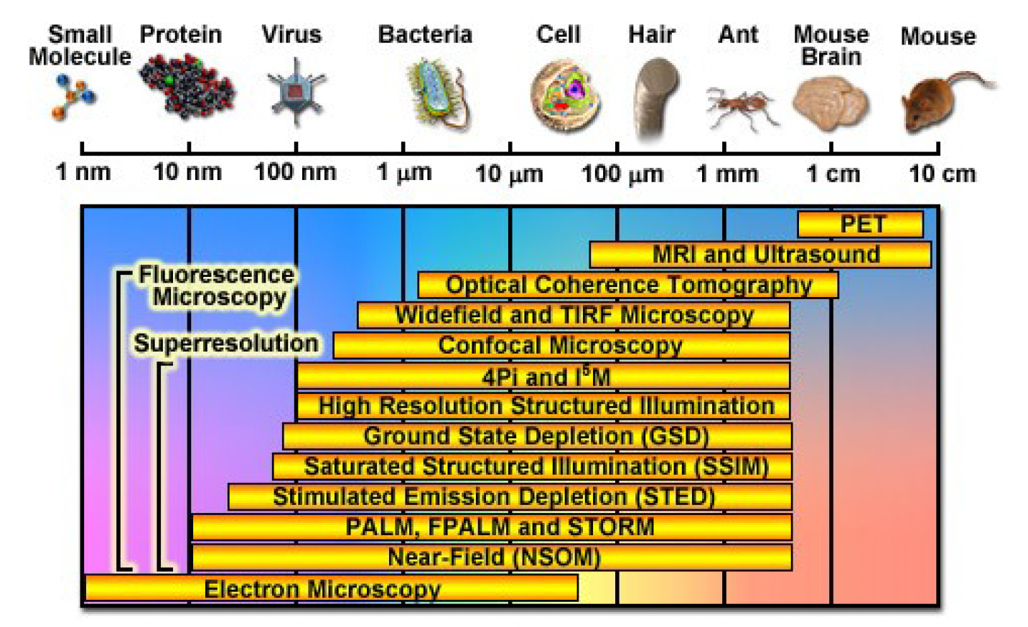
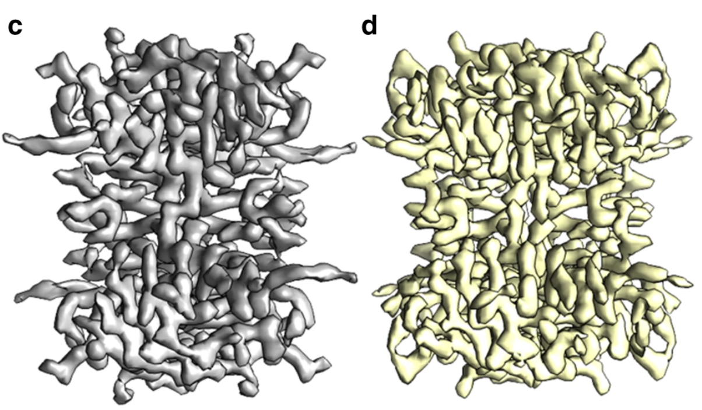
Single-cell, single-molecule – The next level in cell biology
single-cell sequencing
cryogenic transmission electron microscopy
single-molecule fluorescence microscopy
https://kursuskatalog.au.dk/en/course/124542/Single-cell-Single-molecule-The-Next-Level-in-Cell-Biology

